Slide 1
Hospital Resource Monitoring System

Slide 2
Problem statement
Hospitals and healthcare centers often struggle with real-time tracking of resource usage, such as ICU beds, ventilators, oxygen supply, and medical staff availability. This inefficiency leads to resource misallocation, long patient wait times, and potential medical emergencies.

Slide 3
Why is this needed?
1.Hospitals struggle with resource shortages (beds, ICU, ventilators, doctors).
2.Manual tracking causes delays in patient care.
3.Lack of real-time visibility results in misallocation of resources.

Slide 4
What will this project solve?
1.Provide a real-time dashboard for hospital administrators.
2.Track hospital capacity, patient influx, and resource availability.
3.Generate insights for better decision-making.

Slide 5
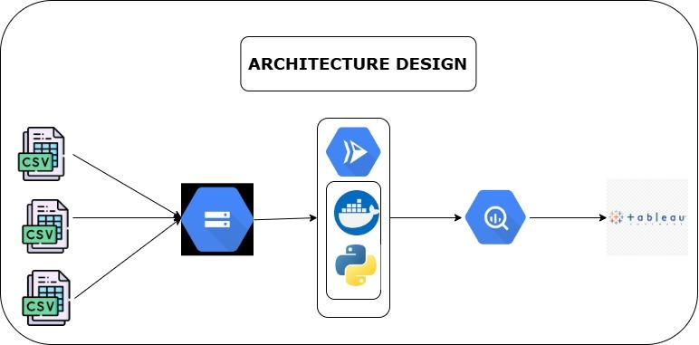
Project Architecture

Slide 6
Requirement gathering
Hospital Resources Data (Primary Dataset) (FROM KAGGLE)
Number of beds (ICU, general, pediatric, maternity, etc.)
Availability of ventilators & oxygen cylinders
Number of doctors, nurses, and staff per shift
Medical equipment status (working/non-working)
Hospital capacity utilization over time
Patient Admission Data (FROM KAGGLE)
Patient count per department (ER, ICU, general ward, maternity, etc.)
Admission & discharge timestamps
Emergency vs. scheduled cases
Real-Time Emergency Data (If possible) (FROM KAGGLE)
Ambulance availability & response times
Nearby hospital referrals in case of overcapacity

Slide 7
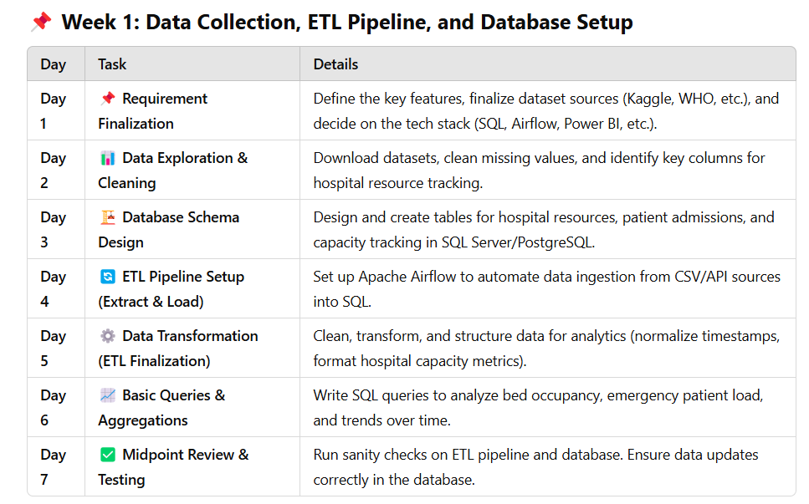
Timeline

Slide 8
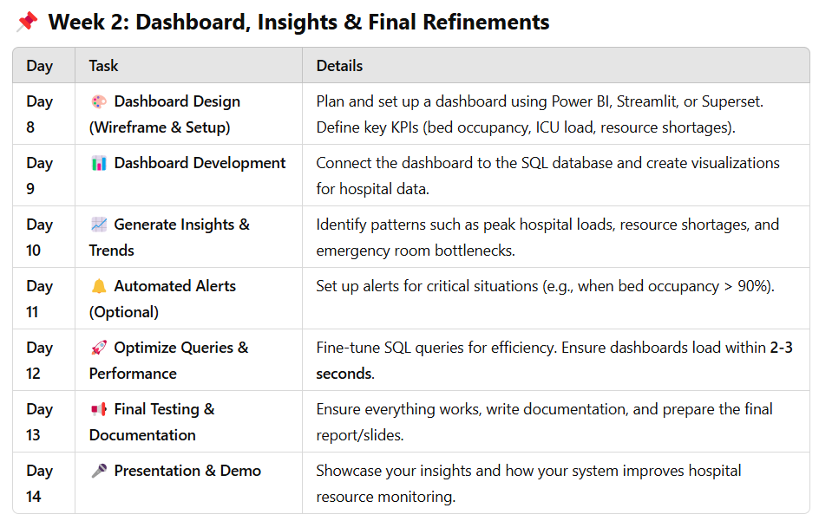
Timeline continuation

Slide 9
TECH STACK
Data Ingestion & ETL Apache Airflow – Orchestrate data pipelines and automate ingestion.
Python (pandas, requests, SQLAlchemy) – Extract, transform, and load (ETL) data.
Docker – Containerize workflows for consistency across environments.
Data Storage PostgreSQL / MySQL – Store structured data (hospital resources, patient records, etc.).

Slide 10
Data Processing & Aggregation Apache Spark / Pandas – Process large datasets efficiently
Visualization & Dashboards Tableau / Power BI – Create insightful dashboards.
Metabase / Superset – Open-source alternative for dashboards.

Slide 11
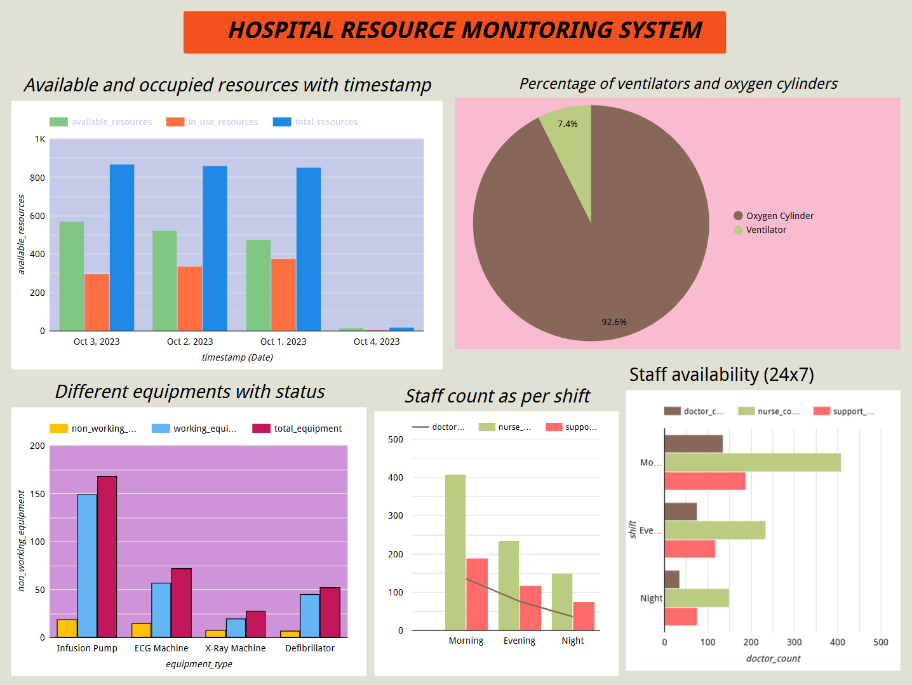
Dashboard

Slide 12
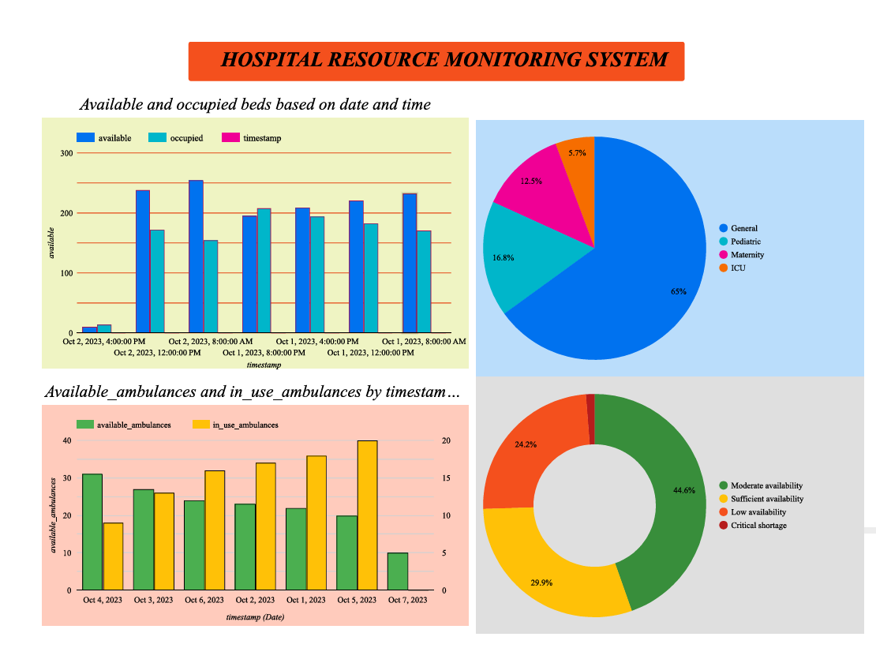

Slide 13
Challenges Faced
1.Schema related issues while table creation in bigquery →solved by writing python script to automate the table creation.
2.file not detected (or) no such file exists while running container
→The issue we believe was the file path in docker file was not recognized by docker engine, Solved by specifying file name.
3.Error while building an image in cloud run →solved by specifying correct port details.

Slide 14


